Slide 1
Double Compression of JPEG Image using DCT Using Threshold Value
Minor Project Presentation
Guide :
Mrs Aekta Singh
Mrs Anjali Mehta
By:-
T Apoorva Singh 30210403014
Vasu Tyagi 00210407615
Saurabh Kumar 40210407615

Slide 2
Table of Contents
Overview of Project.
About JPEG.
Basics of JPEG compression.
Double Compression.
Algorithm for Compression.
Comparison with Other Image Formats.
Applications.
Merits of JPEG Compression.
Pert Chart
Results

Slide 3
Overview
Reduces redundancy and data size of image.
Used for efficient storage, retrieval and transmission.
2 types: Lossy(Lower Quality) and Lossless(Original Quality).
Aiming to achieve the best compression ratio using DCT.
Discrete Cosine Transform (DCT) transforms digital image data from the spatial domain to the frequency domain.

Slide 4
About JPEG
Stands for Joint Photographics Experts Group.
Lossy compression method.
Mostly used by digital cameras & web usage.
Not suited for drawing , textual and iconic graphics.
JPEG is a still frame compression standard based on the DCT.
JPEG can achieve high compression ratios with little loss in quality.

Slide 5
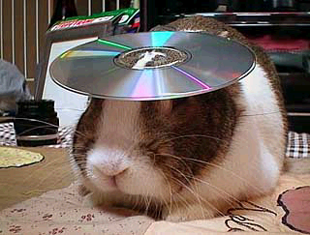

Basics of JPEG Compression
Human vision is insensitive to high spatial frequencies
JPEG Takes advantage of this by compressing high frequencies more coarsely and storing image as frequency data
Losslessly compressed
150KB
JPEG compressed
14KB

Slide 6
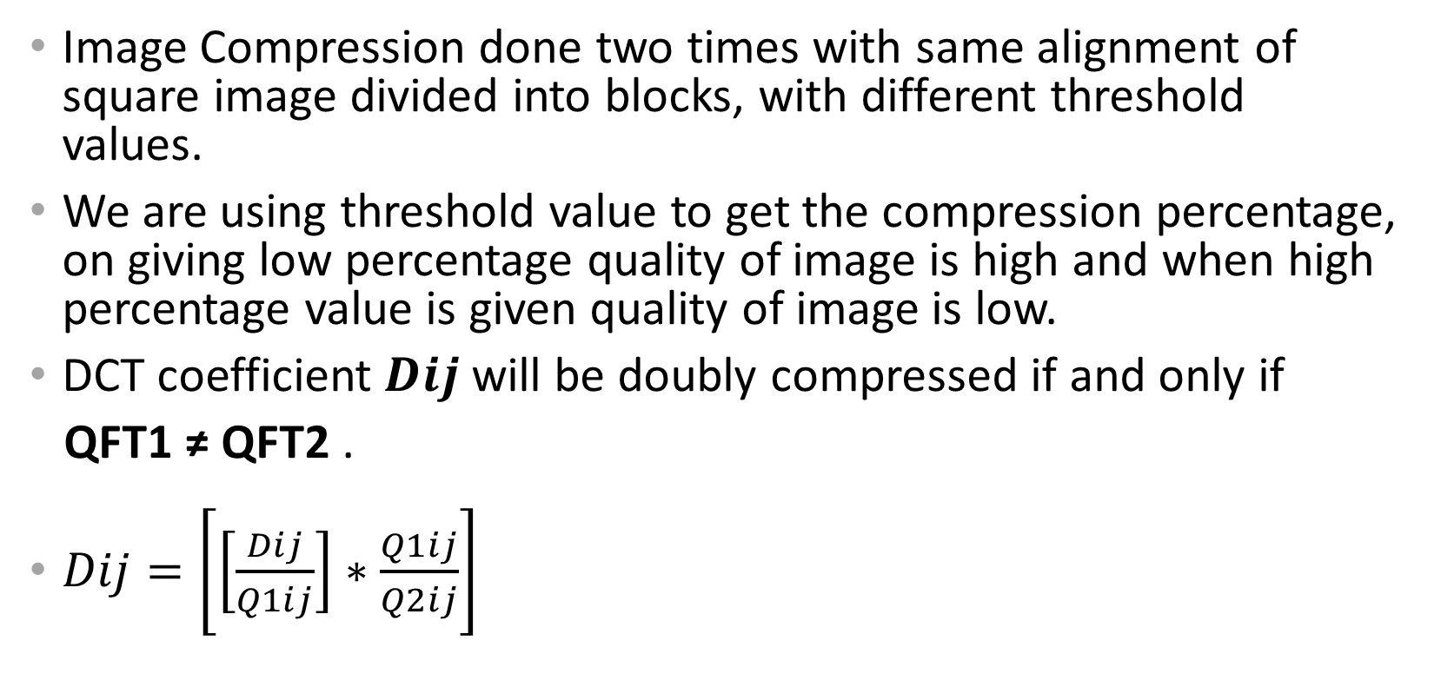
Double Compression using DCT
Image Compression done two times with same alignment of square image divided into blocks, with different threshold values.
We are using threshold value to get the compression percentage, on giving low percentage quality of image is high and when high percentage value is given quality of image is low.
DCT coefficient $Dij$will be doubly compressed if and only if
QFT1 ≠ QFT2 .
$Dij=\left[\left[\frac{Dij}{Q1ij}\right]∗\frac{Q1ij}{Q2ij}\right]$

Slide 7
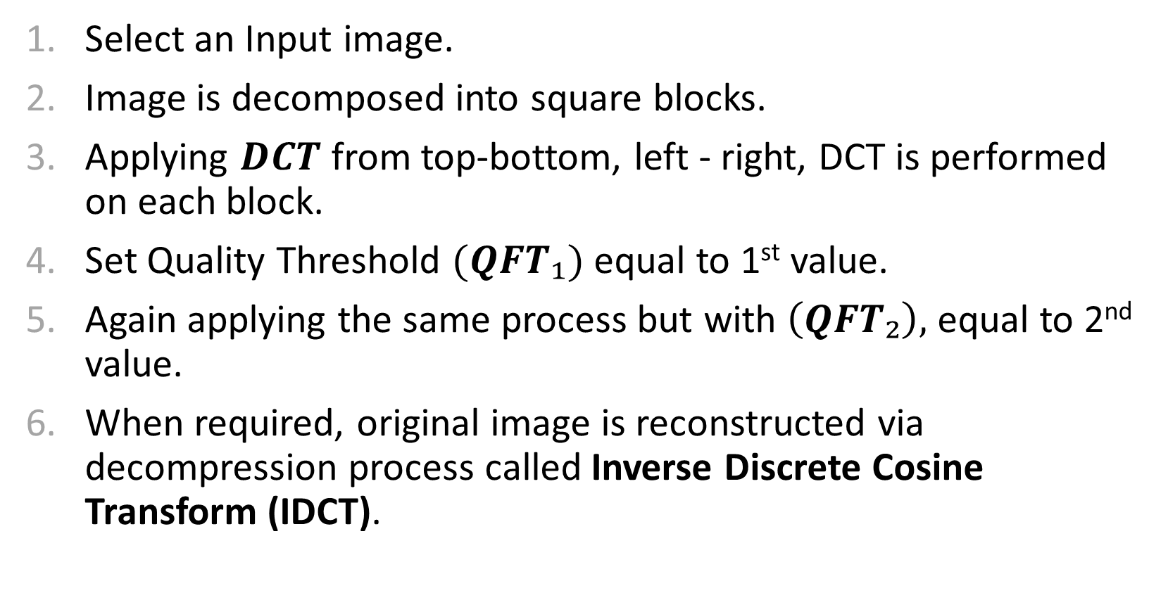
DCT Algorithm
Select an Input image.
Image is decomposed into square blocks.
Applying $DCT$from top-bottom, left - right, DCT is performed on each block.
Set Quality Threshold $(QFT₁)$ equal to 1st value.
Again applying the same process but with $\left(QFT₂\right),$ equal to 2nd value.
When required, original image is reconstructed via decompression process called Inverse Discrete Cosine Transform (IDCT).

Slide 8
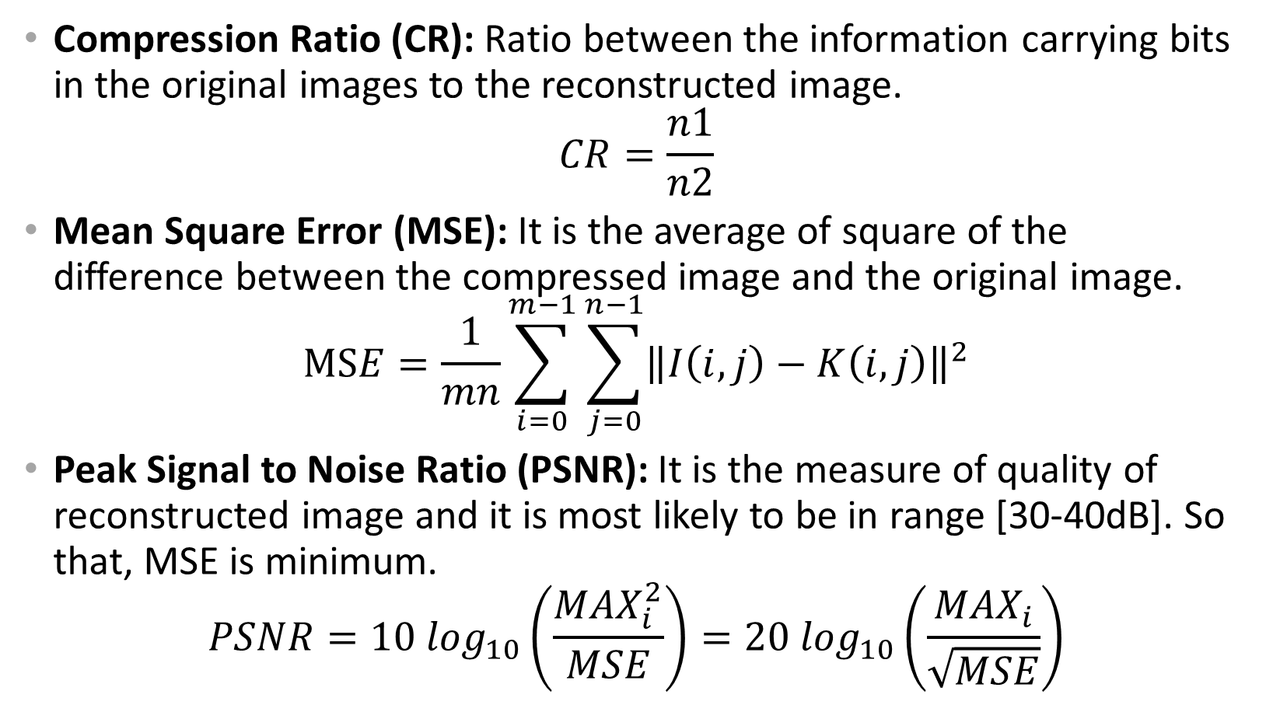
Measurement Factors
Compression Ratio (CR): Ratio between the information carrying bits in the original images to the reconstructed image.
$$CR=\frac{n1}{n2}$$
Mean Square Error (MSE): It is the average of square of the difference between the compressed image and the original image.
$$MSE=\frac{1}{mn}\sum_{i=0}^{m−1}{\sum_{j=0}^{n−1}{{\left\|I\left(i,j\right)−K\left(i,j\right)\right\|}^{2}}}$$
Peak Signal to Noise Ratio (PSNR): It is the measure of quality of reconstructed image and it is most likely to be in range [30-40dB]. So that, MSE is minimum.
$$PSNR=10 \log_{10}\left(\frac{{MAX}_{i}^{2}}{MSE}\right)=20\log_{10}\left(\frac{{MAX}_{i}}{\sqrt{MSE}}\right)$$

Slide 9
Comparison
GIF Compression(Graphics Interchange Format):
Supports a maximum of 256 colors.
Uses a lossless LZW compression algorithm.
PNG Compression(Portable Network Graphic):
Better average compression than GIF.
Supports 24-bit images.
TIFF Compression(Tagged Interchange File Format):
Highly flexible and platform-independent format.
Supports multiple algorithms, both lossless and lossy.

Slide 10
Applications
Image Editing
Optical Sorting
Face Detection
Augmented Reality
Remote Sensing
Medical Image Processing

Slide 11
Merits of JPEG Compression
Works with colour and grayscale images, but not with binary images.
Up to 24 bit colour images (Unlike GIF)
Target photographic quality images (Unlike GIF)
Suitable for many applications e.g., satellite, medical, general photography, etc.
Widely used all over and supports every system.

Slide 12
Pert chart
Activity | Optimal time(days) | Real time(days)
Research on paper | 7 | 10
Blueprint of project | 5 | 8
Testing algorithms | 7 | 12
Debugging | 3 | 5
Final checking | 3 | 5
Project report | 10 | 15
Completion | 35 | 55

Slide 13
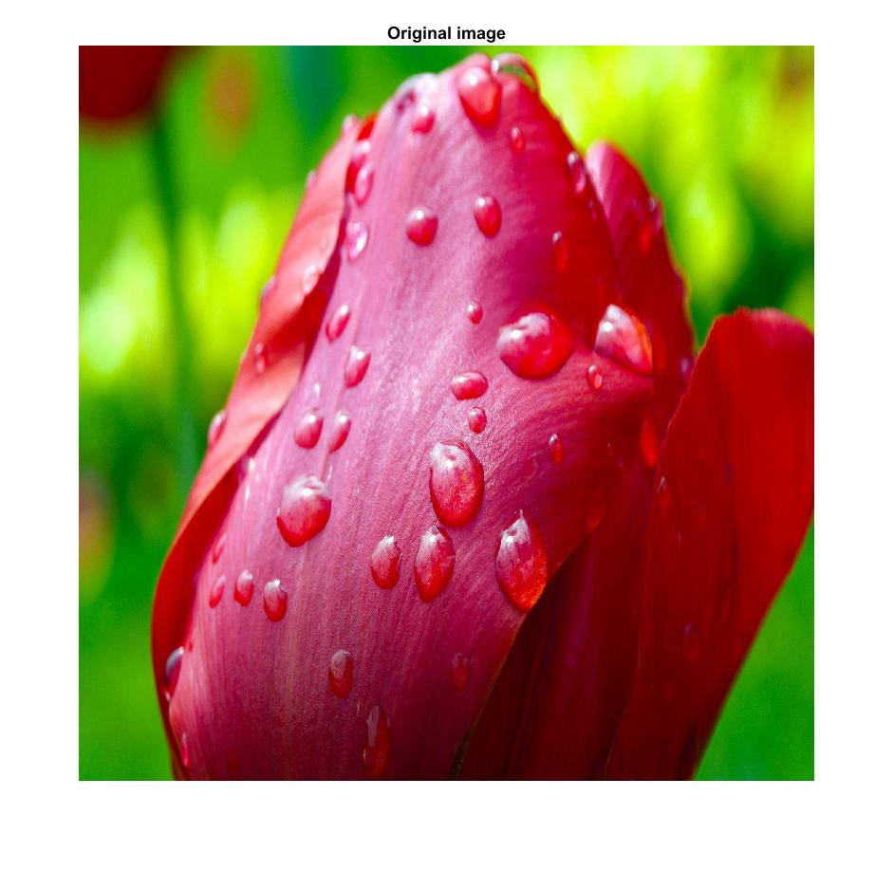
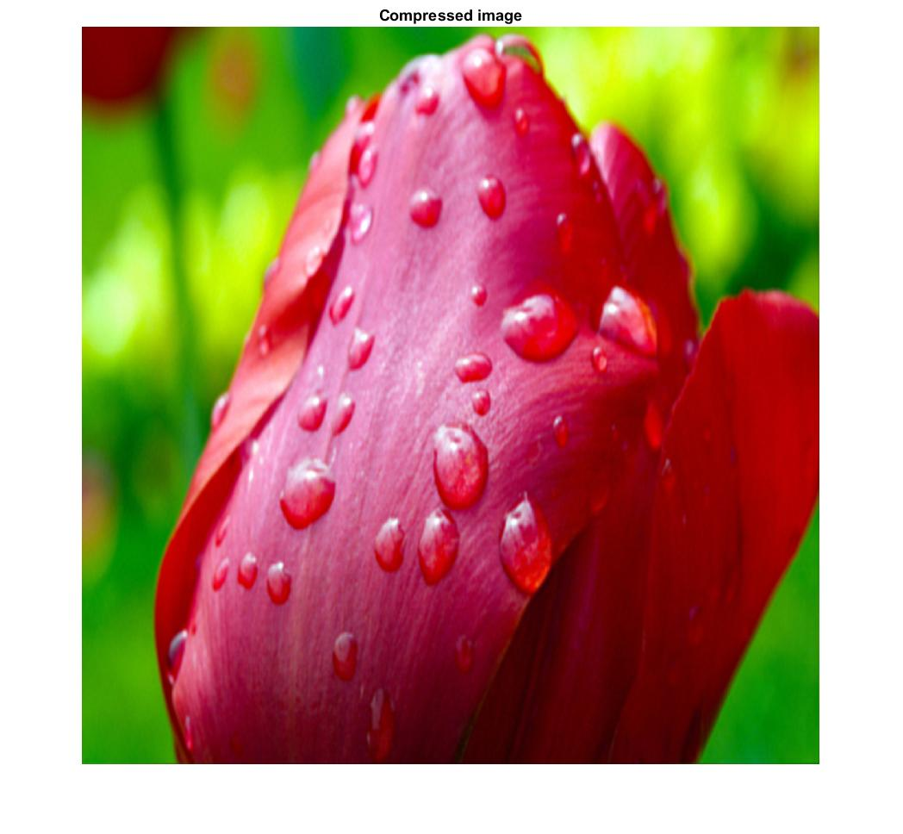
Original image Compressed Image

Slide 14
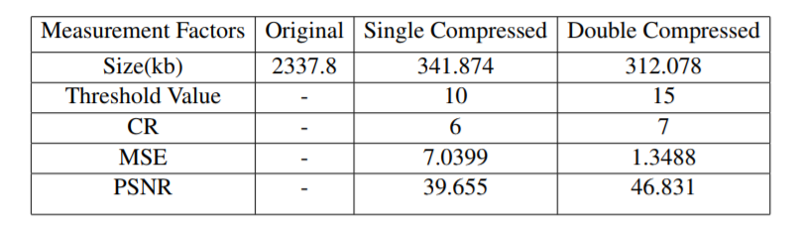
Compression Parameters

Slide 15
References
Ankit Chouhan and M.l Nigam, “Double Compression of JPEG Image using DCT with Estimated Quality Factor”, 1st IEEE International Conference on Power Electronics, Intelligent Control and Energy Systems (ICPEICES-2016) .

Slide 16
The End.

